Slide 1
Artificial Intelligence
Subject Code : BTCOC701:
B Tech CSE (Sem I)
w.e.f. 23-24

Slide 2
What is Artificial Intelligence
AI encompasses
Logic, Probability and Continuous Mathematics
perception, reasoning, learning, and action
and everything from microelectronic devices to robotic planetary explorers.

Slide 3
Types of AI
Strong AI and Weak AI
Strong AI, like a brilliant character in a science fiction film, might reason, learn, and accomplish tasks in the same way that humans do.
Weak AI, on the other hand, concentrates on performing one thing well, such as recommending movies, providing us with directions, or even assisting us in creating the ideal playlist.

Slide 4
Weak AI Vs Strong AI
Weak AI does not acquire self-awareness or display the full spectrum of human cognitive capacities. Weak AI refers to systems that are programmed to solve a wide variety of issues yet only perform a limited set of operations.
Strong AI, on the other hand, refers to robots that can think like humans.

Slide 5
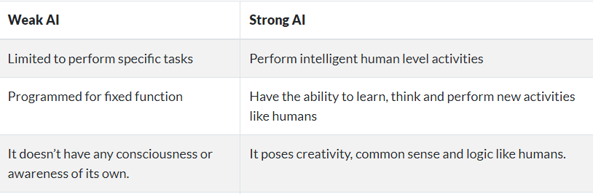
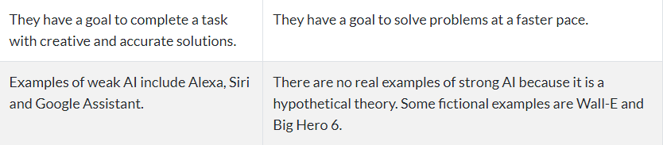

Slide 6
Syllabus
[Unit 1] Introduction:
What Is AI? The Foundations of Artificial Intelligence, the History of Artificial Intelligence, the State of the Art.
Intelligent Agents: Agents and Environments Good Behavior: The Concept of Rationality, The Nature of Environments, The Structure of Agents.

Slide 7
Syllabus
[Unit 2] Problem-solving:
Solving Problems by Searching, Problem-Solving Agents, Example Problems, Searching for Solutions,
Uninformed Search Strategies, Informed (Heuristic) Search Strategies, Heuristic Functions, Defining
Constraint Satisfaction Problems, Constraint Propagation: Inference in CSPs, Backtracking Search for CSPs, Local Search for CSPs, The Structure of Problems.
Adversarial Search, Games, Optimal Decisions in Games, Alpha–Beta Pruning.

Slide 8
Syllabus
[Unit 3]Knowledge & Reasoning :
Knowledge representation issues, Representation & mapping, Approaches to knowledge representation, Issues in knowledge representation.
Using predicate logic: Representing simple fact in logic, Representing instant & ISA relationship, Computable functions & predicates, Resolution, Natural deduction.
Representing knowledge using rules: Procedural verses declarative knowledge, Logic programming, Forward verses backward reasoning, Matching, Control knowledge.

Slide 9
Syllabus
[Unit 4] Probabilistic Reasoning
Representing knowledge in an uncertain domain, The semantics of Bayesian networks, Dempster-Shafer theory,
Fuzzy sets & fuzzy logics, Planning: Overview, Components of a planning system, Goal stack planning, Hierarchical planning and other planning techniques.

Slide 10
Syllabus
Unit5] Natural Language processing:
Introduction, Syntactic processing, Semantic analysis, Discourse & pragmatic processing. Learning: Forms of learning, Inductive learning, Learning decision trees, explanation based learning, Learning using relevance information,
Neural net learning & genetic learning.
Expert Systems: Representing and using domain knowledge, Expert system shells and knowledge acquisition.

Slide 11
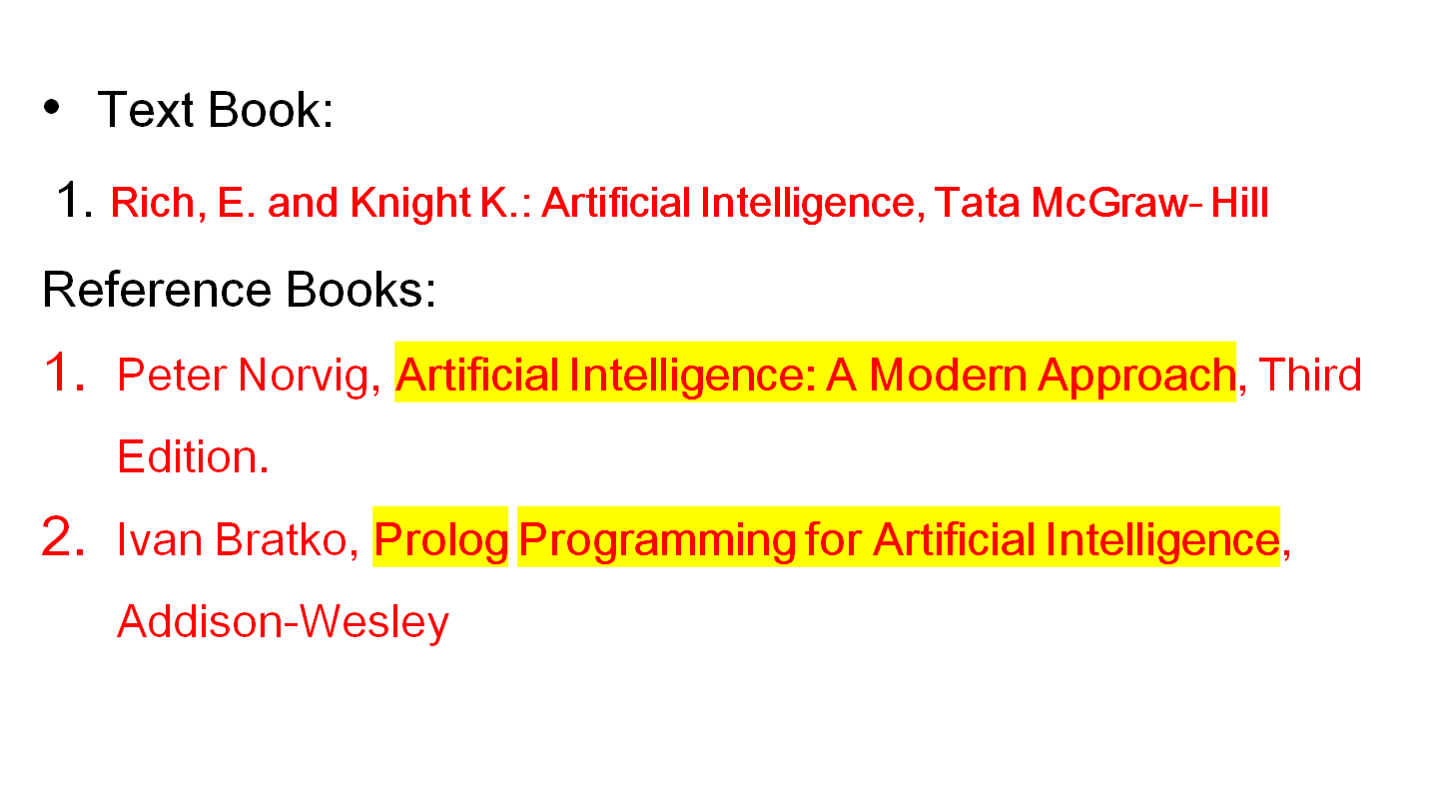
References

Slide 12
Course Outcomes
By the end of the course students will able to
CO1: To describe the concepts of Artificial Intelligence, Intelligent Agents, Logical Agents. (BTL2 : Understand)
CO2: To solve search problems, constraint satisfaction problems and adversarial search algorithms problems.(BTL3 : Apply)
CO3: To carry out proofs in first order and propositional logic using techniques such as resolution, unification, backward and forward chaining. (BTL3 : Apply)
CO4: To describe representation knowledge in an uncertain domain. (BTL2 : Understand)
CO5: To describe use of Artificial Intelligence in Natural Language Processing. (BTL2 : Understand)

Slide 13
Introduction
What is AI?
The foundations of AI
A brief history of AI
The state of the art
Introductory problems

Slide 14
What is Artificial Intelligence?
Intelligence: “ability to learn, understand and think”
Intelligence is the efficiency with which you can acquire new skills at tasks you didn’t previously prepare for.
AI is the Intelligence by Machine.
Any system that perceives its environment & takes actions that maximize its chance of achieving its goals.

Slide 15
What is AI?
Intelligence: “ability to learn, understand and think”
AI is the study of how to make computers do the things which at the moment people do better.
Examples: Speech recognition, Face, Object, Perception, Inference, Learning new skills, Decision making, Knowledge representation, learning, NLP

Slide 16
Patrick Winston, the Ford professor of artificial intelligence and computer science at MIT, defines AI as
"algorithms enabled by constraints, exposed by representations that support models targeted at loops that tie thinking, perception and action together."

Slide 17
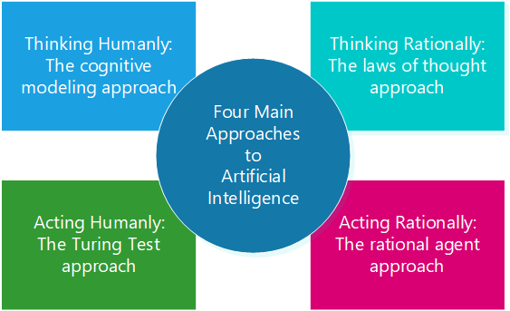

Slide 18
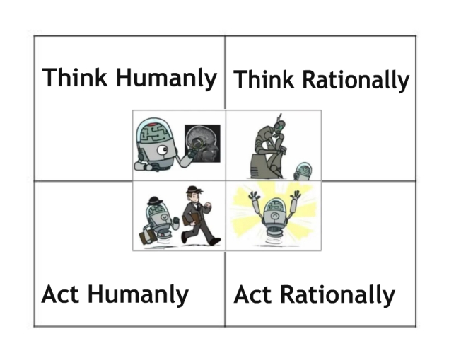

Slide 19
What is AI?
Thinking humanly The exciting new efforts to make computer think… machines with minds, in the full & literal sense (1985). “ The automation of] activities that we associate with human thinking such as decision-making, problem solving, learning….”(1978) | Thinking rationally The study of mental faculties through the use of computational models.(1985) The study of the computations that make it possible to perceive, reasons & act.(1992)
Acting humanly The art of creating machines that perform functions that require intelligence when performed by people.(1990) The study of how to make computers do things at which, at the moment people do better.(1991) | Acting rationally Computational Intelligence is the study of the design of Intelligent agents.(1998) “ AI …. is concerned with intelligent behaviour in artifacts” (1998)

Slide 20



Acting Humanly: The Turing Test
Alan Turing (1912-1954)
“Computing Machinery and Intelligence” (1950)
Imitation Game
Human
Human Interrogator
AI System

Slide 21

Turing Test…Cont….
Turing (1950) "Computing machinery and intelligence":
"Can machines think?" → "Can machines behave intelligently?"
Operational test for intelligent behavior: the Imitation Game
Predicted that by 2000, a machine might have a 30% chance of fooling a lay person for 5 minutes
Anticipated all major arguments against AI in following 50 years
Suggested major components of AI: NLP, knowledge representation, automated reasoning, machine learning, Robotics

Slide 22
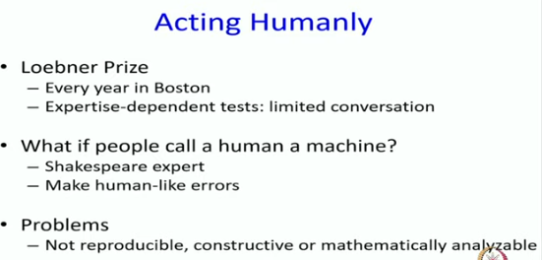

Slide 23
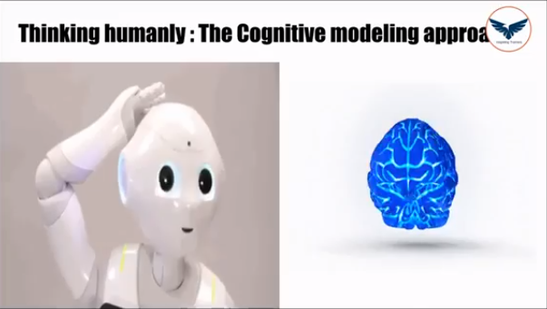
Thinking Humanly: Cognitive Modelling

Slide 24
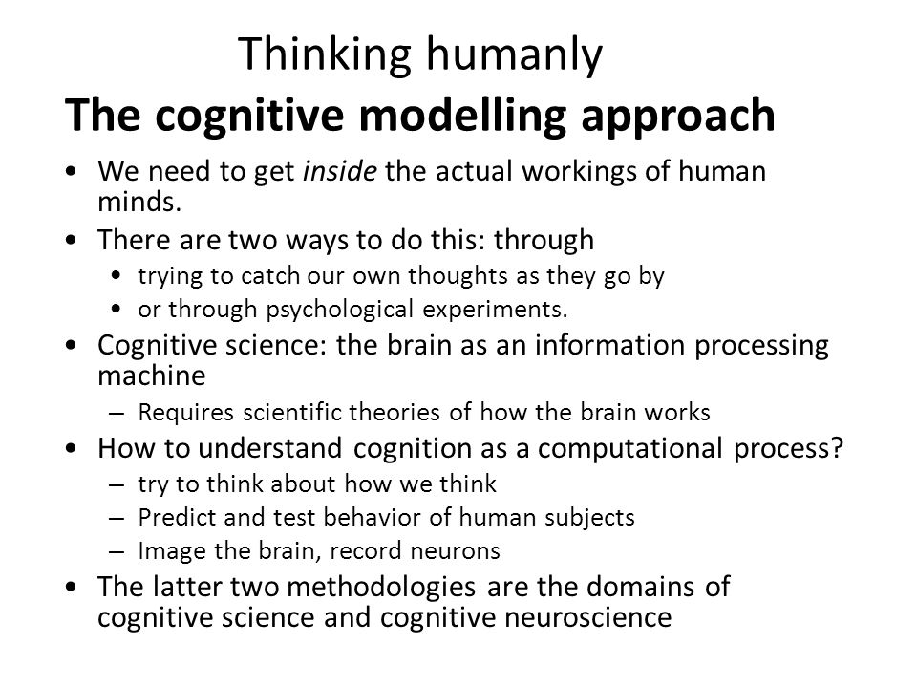

Slide 25
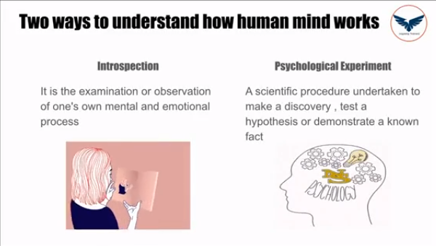

Slide 26
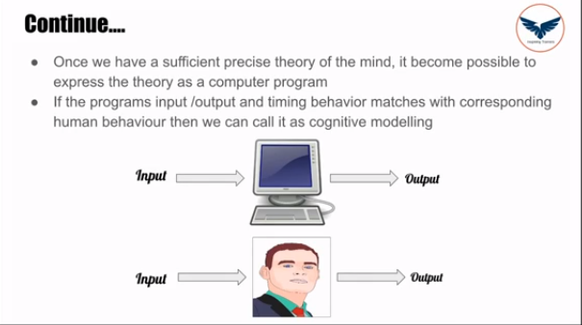


Slide 27
Thinking Rationally (Logically/ Reasonably): Laws of Thought
Aristotle was one of the first to attempt to codify “right thinking”, i.e., unquestionable reasoning processes.
Formal logic provides a precise notation and rules for representing and reasoning with all kinds of things in the world.
Obstacles:
− Require 100% knowledge representation.
− Computational complexity and resources.

Slide 28
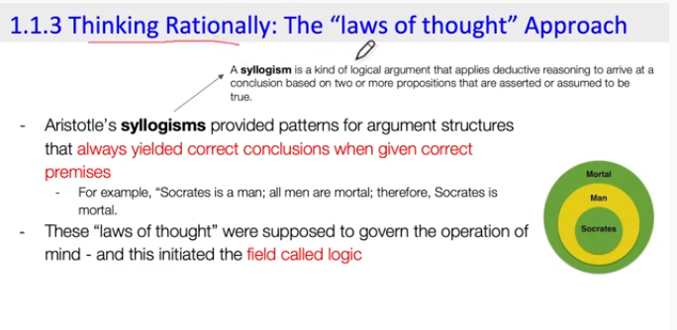
Thinking Rationally (Logically/ Reasonably): Laws of Thought

Slide 29
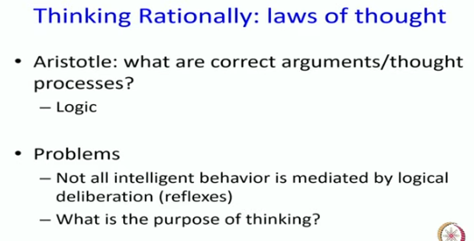

Slide 30
Acting Rationally (Rational Agent Approach)
Doing / Behaving Rightly
Generalized Approach
Maximizing expected performance.
Best possible outcome
Rational agent is that acts so as achieve best outcome or when there is uncertainty, the best expected output. (with sensors & Actuators based on given information.)

Slide 31
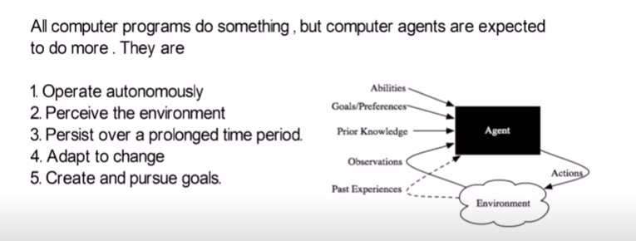
Acting Rationally (Rational Agent Approach)

Slide 32
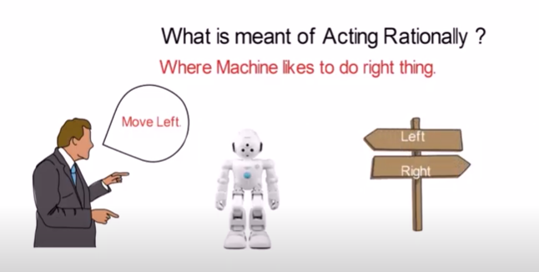
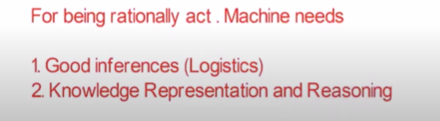
Acting Rationally (Rational Agent Approach)

Slide 33
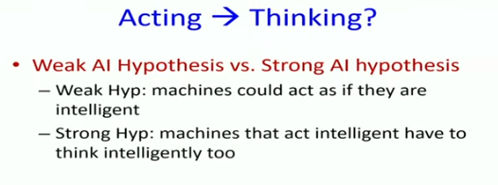

Slide 34
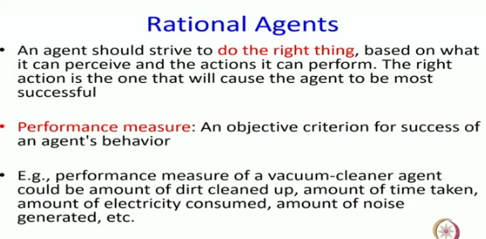

Slide 35
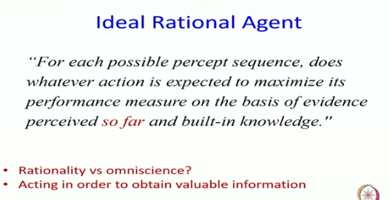

Slide 36
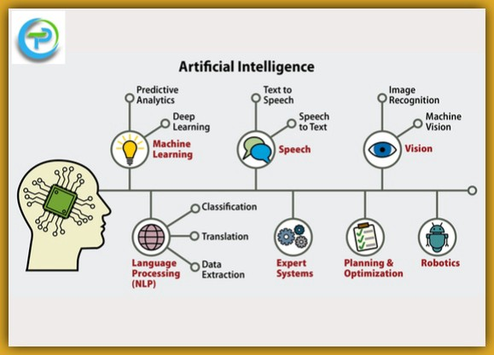

Slide 37
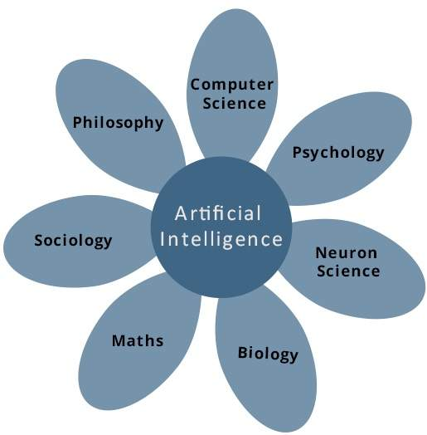
The Foundations of AI

Slide 38
The Foundations of AI
Philosophy (423 BC − present):
− Logic, methods of reasoning.
− physical brain & mental mind.
− Foundations of learning, language, and rationality.
Mathematics (c.800 − present):
− Formal representation and proof.
− Algorithms, computation, decidability, tractability.
− Probability.

Slide 39
The Foundations of AI
Psychology (1879 − present):
− Adaptation.
− Phenomena of perception and motor control.
− Experimental techniques.
Linguistics (1957 − present):
− Knowledge representation.
− Grammar.


Slide 40
A Brief History of AI
The gestation of AI (1943 − 1956):
− 1943: McCulloch & Pitts: Boolean circuit model of brain.
− 1950: Turing’s “Computing Machinery and Intelligence”.
− 1956: McCarthy’s name “Artificial Intelligence” adopted.
Early enthusiasm, great expectations (1952 − 1969):
− Early successful AI programs: Samuel’s checkers,
Newell & Simon’s Logic Theorist, Gelernter’s Geometry
Theorem Prover.
− Robinson’s complete algorithm for logical reasoning.


Slide 41
A Brief History of AI
A dose of reality (1966 − 1974):
− AI discovered computational complexity.
− Neural network research almost disappeared after
Minsky & Papert’s book in 1969.
Knowledge-based systems (1969 − 1979):
− 1969: DENDRAL by Buchanan et al..
− 1976: MYCIN by Shortliffle.
− 1979: PROSPECTOR by Duda et al..



Slide 42
A Brief History of AI
AI becomes an industry (1980 − 1988):
− Expert systems industry booms.

The return of NNs and novel AI (1986 − present):
− Mid 80’s: Back-propagation learning algorithm reinvented.
− Expert systems industry busts.
− 1988: Resurgence of probability.
− 1988: Novel AI (GAs, Soft Computing, …).
− 1995: Agents everywhere.
− 2003: Human-level AI back on the agenda.

Slide 43
AI Problems
Task Domains of AI
Mundane Tasks:
  Perception
    Vision
    Speech
  Natural Languages
    Understanding
    Generation
    Translation
  Common sense reasoning
  Robot Control
Formal Tasks
  Games : chess, checkers etc
  Mathematics: Geometry, logic,Proving properties of programs
Expert Tasks:
  Engineering ( Design, Fault finding, Manufacturing planning)
  Scientific Analysis
  Medical Diagnosis
  Financial Analysis

Slide 44
Agents & Environment
What are Agent and Environment?
An agent is anything that can perceive its environment through sensors and acts upon that environment through effectors.
A human agent has sensory organs such as eyes, ears, nose, tongue and skin parallel to the sensors, and other organs such as hands, legs, mouth, for effectors.
A robotic agent replaces cameras and infrared range finders for the sensors, and various motors and actuators for effectors.
A software agent receives keystrokes, file contents & network packets as sensory inputs and acts on the environment by displaying in the screen, writing files & sending network packets.

Slide 45
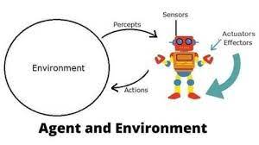
Agents & Environment
What are Agent and Environment?

Slide 46
Agent Terminology
Percept − It is agent’s perceptual inputs at a given instance.
Percept Sequence − It is the history of all that an agent has perceived till date.
Performance Measure of Agent − It is the criteria, which determines how successful an agent is.
Behavior of Agent − It is the action that agent performs after any given sequence of percepts.
Agent Function − It is a map from the precept sequence to an action.

Slide 47
Agent Terminology
Sensor: Sensor is a device which detects the change in the environment and sends the information to other electronic devices. An agent observes its environment through sensors.
Actuators: Actuators are the component of machines that converts energy into motion. The actuators are only responsible for moving and controlling a system. An actuator can be an electric motor, gears, rails, etc.
Effectors: Effectors are the devices which affect the environment. Effectors can be legs, wheels, arms, fingers, wings, fins, and display screen.

Slide 48
Intelligent Agents:
An intelligent agent is an autonomous entity which act upon an environment using sensors and actuators for achieving goals. An intelligent agent may learn from the environment to achieve their goals.
Following are the main four rules for an AI agent:
Rule 1: An AI agent must have the ability to perceive the environment.
Rule 2: The observation must be used to make decisions.
Rule 3: Decision should result in an action.
Rule 4: The action taken by an AI agent must be a rational action.

Slide 49
Intelligent Agents:
This agent has some level of autonomy that allows it to perform specific, predictable, and repetitive tasks for users or applications.
It’s also termed as ‘intelligent’ because of its ability to learn during the process of performing tasks.
The two main functions of intelligent agents include perception and action.
Perception is done through sensors while actions are initiated through actuators.

Slide 50
Characteristics of intelligent agents
They have some level of autonomy that allows them to perform certain tasks on their own.
They have a learning ability that enables them to learn even as tasks are carried out.
They can interact with other entities such as agents, humans, and systems.
New rules can be accommodated by intelligent agents incrementally.
They exhibit goal-oriented habits.
They are knowledge-based. They use knowledge regarding communications, processes, and entities.

Slide 51
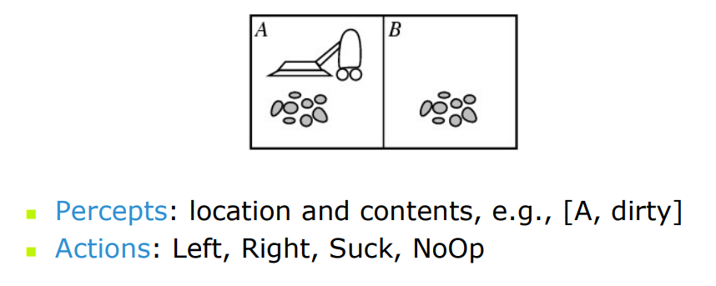
Vacuum-Cleaner Example

Slide 52
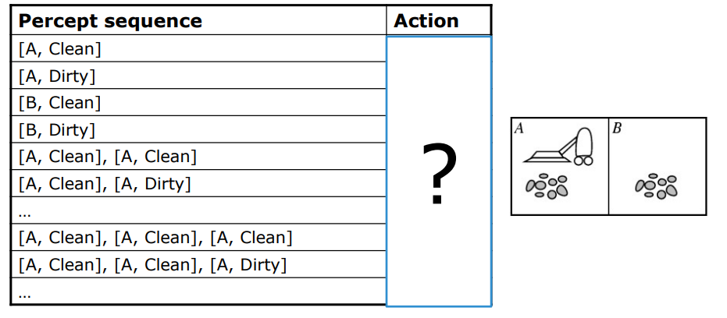
Vacuum-Cleaner Example

Slide 53
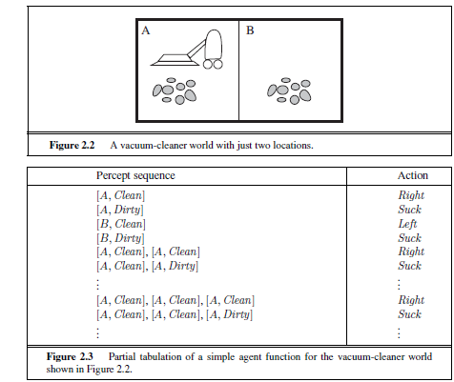
Vacuum-Cleaner Example

Slide 54
Structure of an AI Agent
The task of AI is to design an agent program which implements the agent function.
The structure of an intelligent agent is a combination of architecture and agent program.
It can be viewed as:
Agent = Architecture + Agent program
Following are the main three terms involved in the structure of an AI agent:
Architecture: Architecture is machinery that an AI agent executes on.
Agent Function: Agent function is used to map a percept to an action.
f:P* → A

Slide 55
Agent program: Agent program is an implementation of agent function.
An agent program executes on the physical architecture to produce function f.

Slide 56
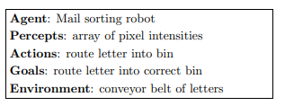
Examples

Slide 57
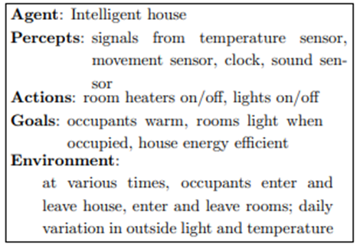
Examples

Slide 58
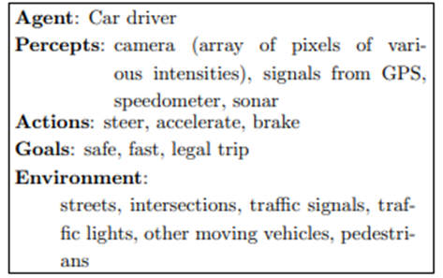
Examples

Slide 59
PEAS Representation
PEAS is a type of model on which an AI agent works upon. When we define an AI agent or rational agent, then we can group its properties under PEAS representation model.
It is made up of four words:
P: Performance measure
E: Environment
A: Actuators
S: Sensors
Here performance measure is the objective for the success of an agent's behavior.

Slide 60
PEAS for self-driving cars:
Let's suppose a self-driving car then PEAS representation will be:
Performance: Safety, time, legal drive, comfort
Environment: Roads, other vehicles, road signs, pedestrian
Actuators: Steering, accelerator, brake, signal, horn
Sensors: Camera, GPS, speedometer, odometer, accelerometer, sonar.

Slide 61
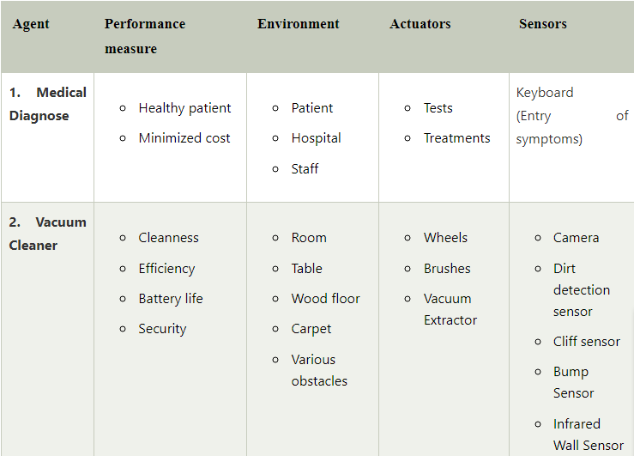
Example of Agents with their PEAS representation

Slide 62
Example of Agents with their PEAS representation
3. Part -picking Robot | Percentage of parts in correct bins. | Conveyor belt with parts, Bins | Jointed Arms Hand | Camera Joint angle sensors.

Slide 63
Types of Environment
Fully Observable vs. Partially Observable
If an agent sensor can sense or access the complete state of an environment at each point of time then it is a fully observable environment, else it is partially observable.
Could be partially observable due to noisy, inaccurate or missing sensors, or inability to measure everything that is needed
A fully observable environment is easy as there is no need to maintain the internal state to keep track history of the world.
An agent with no sensors in all environments then such an environment is called as unobservable.

Slide 64
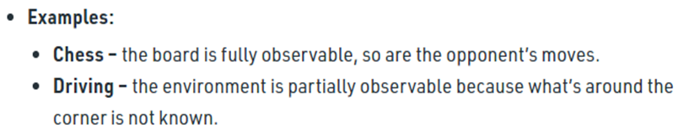
Types of Environment

Slide 65
Types of Environment
Single agent vs. multi agent:
An agent operating by itself in an environment is single agent!
Multi agent is when other agents are present!
A strict definition of an other agent is anything that changes from step to step.
A stronger definition is that it must sense and act.
Competitive or co-operative Multi-agent environments
Human users are an example of another agent in a system
E.g. Other players in a football team (or opposing team), wind and waves in a sailing agent, other cars in a taxi drive

Slide 66
Types of Environment
Single agent vs. multi agent:
An agent solving a crossword puzzle by itself is a single agent environment.
Agent playing chess is in a two agent environment.
In chess, the opponent entity B is trying to maximize its performance measures, which by the rule of chess, minimizes agent A’s performance. Thus chess is Competitive Multiagent environment.
In Taxi-driving environment, avoiding collision maximizes the performance of all agents, so it is partially cooperative multiagent.

Slide 67
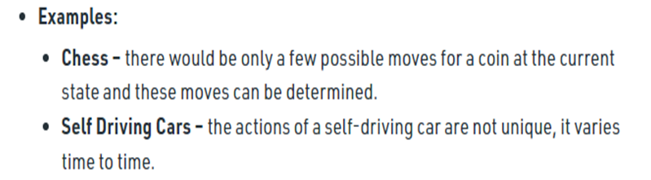
Types of Environment
Deterministic vs. stochastic (non-deterministic):
Deterministic = the next state of the environment is completely predictable from the current state and the action executed by the agent.
Stochastic = the next state has some uncertainty associated with it
Uncertainty could come from randomness, lack of a good environment model, or lack of complete sensor coverage.
If the environment is partially observable, then it could appear to be stochastic.

Slide 68
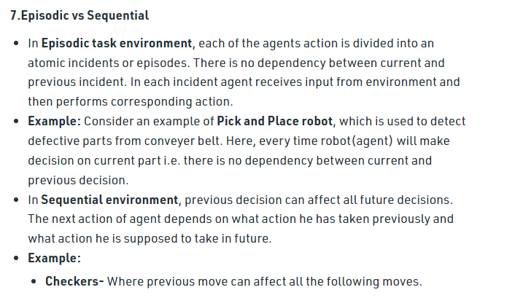
Types of Environment

Slide 69
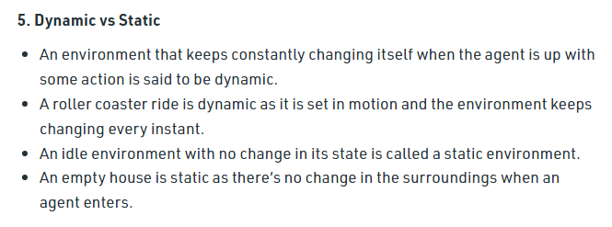
Types of Environment

Slide 70
Types of Environment
Static vs. Dynamic
Static environment are easy to deal with because the agent need not keep looking at the world while it is deciding on an action nor need to worry about the time.
Dynamic environment are continuously asking the agent what it wants to do.
If the environment itself does not change with the passage of time but the agent’s performance score does, then the environment is semidynamic.
Taxi driving is clearly dynamic, chess when played with a clock is semidynamic and crossword puzzles are static.

Slide 71
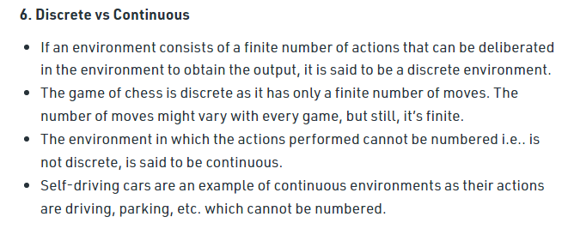
Types of Environment

Slide 72
Types of Environment
Known vs. Unknown
In known environment, the outcome for all actions are given. (Smart Home)
If the environment is unknown, the agent will have to learn how it works in order to make good decision. (Self driving cars)
It is not same as fully observable and partially observable.
Known environment can be partially observable for example – Solitaire card game.
Unknown environment can be fully observable like in video game, the screen may show the entire game state but still don’t know what the buttons do until we try them.

Slide 73
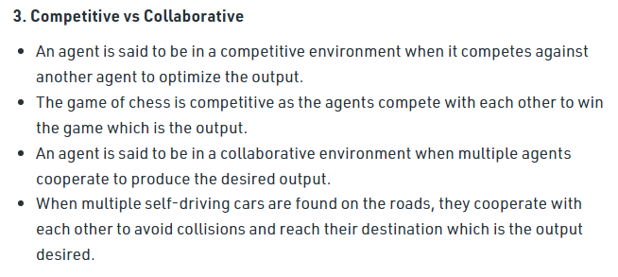
Types of Environment

Slide 74
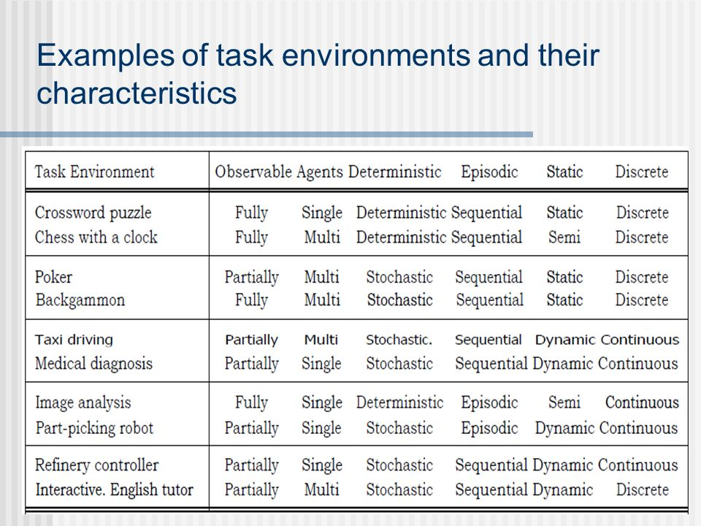

Slide 75
Types of AI Agents
Agents can be grouped into five classes based on their degree of perceived intelligence and capability. All these agents can improve their performance and generate better action over the time. These are given below:
Simple Reflex Agent
Model-based reflex agent
Goal-based agents
Utility-based agent
Learning agent

Slide 76
Simple Reflex agent:
The Simple reflex agents are the simplest agents. These agents take decisions on the basis of the current percepts and ignore the rest of the percept history.
These agents only succeed in the fully observable environment.
The Simple reflex agent does not consider any part of percepts history during their decision and action process.
The Simple reflex agent works on Condition-action rule, which means it maps the current state to action. Such as a Room Cleaner agent, it works only if there is dirt in the room.

Slide 77
Simple Reflex agent:
If the environment associated with this agent is fully observable, only then is the agent function successful, if it is partially observable, in that case the agent function enters into infinite loops that can be escaped only on randomization of its actions.
Problems for the simple reflex agent design approach:
  They have very limited intelligence
  They do not have knowledge of non-perceptual parts of the current state
  Mostly too big to generate and to store.
  Not adaptive to changes in the environment.

Slide 78
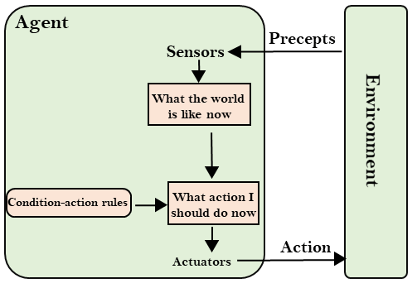
Simple Reflex Agents

Slide 79
Model-Based Agents:
The Model-based agent can work in a partially observable environment, and track the situation.
A model-based agent has two important factors:
  Model: It is knowledge about "how things happen in the world," so it is called a Model-based agent.
  Internal State: It is a representation of the current state based on percept history.
These agents have the model, "which is knowledge of the world" and based on the model they perform actions.
Updating the agent state requires information about:
  How the world evolves
  How the agent's action affects the world.

Slide 80
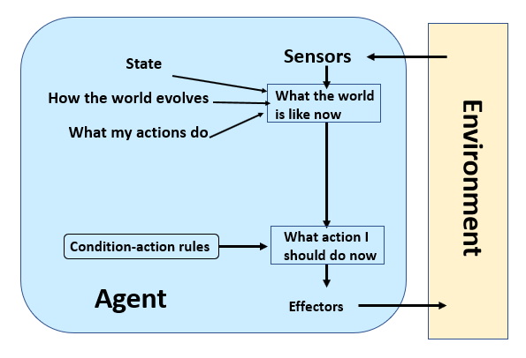
Model-Based Agents:

Slide 81
Model-Based Agents:
These are the agents with memory.
It stores the information about the previous state, the current state and performs the action accordingly.
Just as while driving, if the driver wants to change the lane, he looks into the mirror to know the present position of vehicles behind him.
While looking in front, he can only see the vehicles in front, and as he already has the information on the position of vehicles behind him (from the mirror a moment ago), he can safely change the lane.
The previous and the current state get updated quickly for deciding the action.

Slide 82
Goal-based agents
The knowledge of the current state environment is not always sufficient to decide for an agent to what to do.
The agent needs to know its goal which describes desirable situations.
Goal-based agents expand the capabilities of the model-based agent by having the "goal" information.
They choose an action, so that they can achieve the goal.
These agents may have to consider a long sequence of possible actions before deciding whether the goal is achieved or not. Such considerations of different scenario are called searching and planning, which makes an agent proactive.

Slide 83
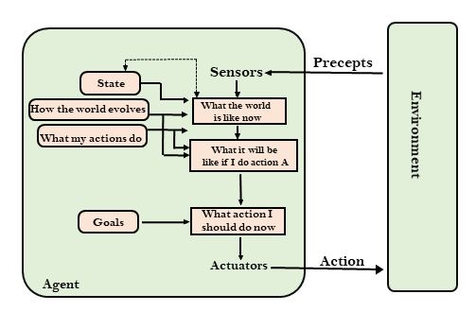
Goal-based agents

Slide 84
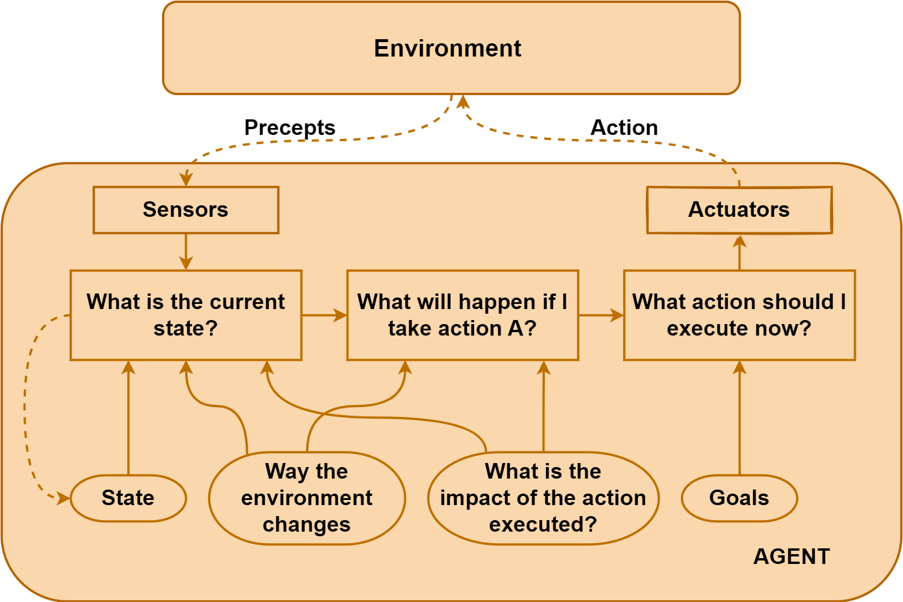

Slide 85
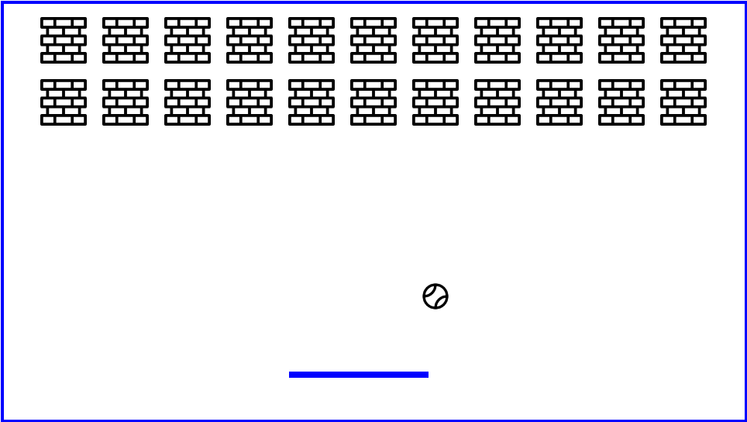
Breakout Game

Slide 86
In this game, the goal-based agent aims to destroy all the bricks in order to gain maximum reward.
To achieve this goal, the agent must use its paddle to hit the ball and destroy all the bricks.
Additionally, the agent needs to continuously evaluate its environment and take actions likely to lead it closer to its goal.
Here, the agent learns by exploring the environment and setting rules for maximizing the reward.

Slide 87
Example
In some circumstances, just the information of the current state may not help in making the right decision. If the goal is known, then the agent takes into account the goal information besides the current state information to make the right decision. For, e.g., if the agent is a self-driving car and the goal is the destination, then the information of the route to the destination helps the car in deciding when to turn left or right.
Search’ and ‘planning’ are the two subfields of AI that help the agent achieve its goals. Though the goal-based agent may appear less efficient, yet it is flexible. Considering the same example mentioned above, if the destination changes then the agent will manipulate its actions accordingly. This will not be the case with the reflex agent as all the rules need to be rewritten with the change in goal

Slide 88
Utility-based agents
These agents are similar to the goal-based agent but provide an extra component of utility measurement which makes them different by providing a measure of success at a given state.
Utility-based agent act based not only goals but also the best way to achieve the goal.
Utility describes how “happy” the agent is. Because of the uncertainty in the world, a utility agent chooses the action that maximizes the expected utility.
The Utility-based agent is useful when there are multiple possible alternatives, and an agent has to choose in order to perform the best action.
The utility function maps each state to a real number to check how efficiently each action achieves the goals.

Slide 89
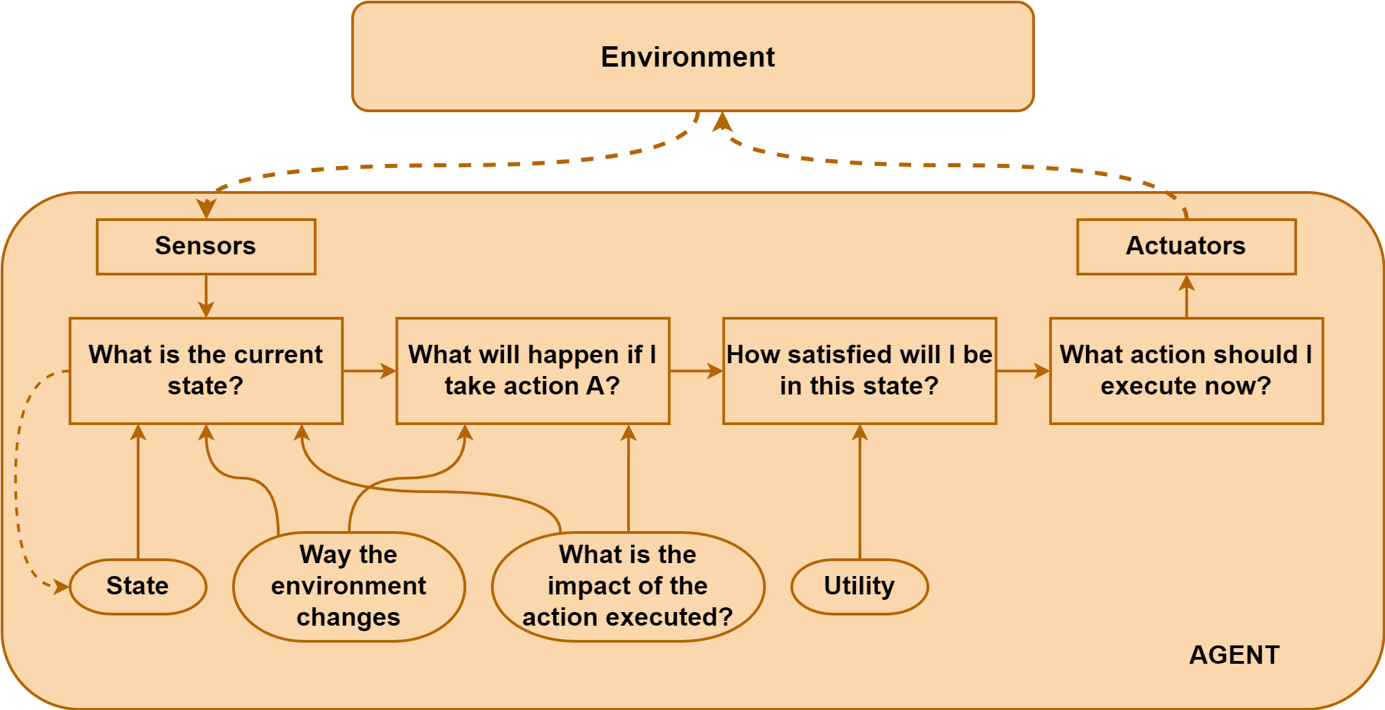
Utility-based agents

Slide 90
Example
There can be many possible sequences to achieve the goal, but some will be better than others. Considering the same example mentioned above, the destination is known, but there are multiple routes. Choosing an appropriate route also matters to the overall success of the agent. There are many factors in deciding the route like the shortest one, the comfortable one, etc. The success depends on the utility of the agent-based on user preferences.
Another example, let’s show our mars Lander on the surface of mars with an obstacle in its way. In a goal-based agent it is uncertain which path will be taken by the agent and some are clearly not as efficient as others but in a utility-based agent the best path will have the best output from the utility function and that path will be chosen

Slide 91
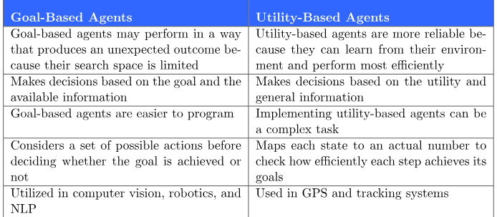

Slide 92
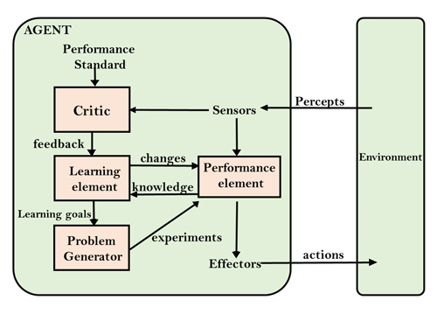
Learning Agents

Slide 93
Learning Agents
A learning agent in AI is the type of agent which can learn from its past experiences, or it has learning capabilities.
It starts to act with basic knowledge and then able to act and adapt automatically through learning.
A learning agent has mainly four conceptual components, which are:

Slide 94
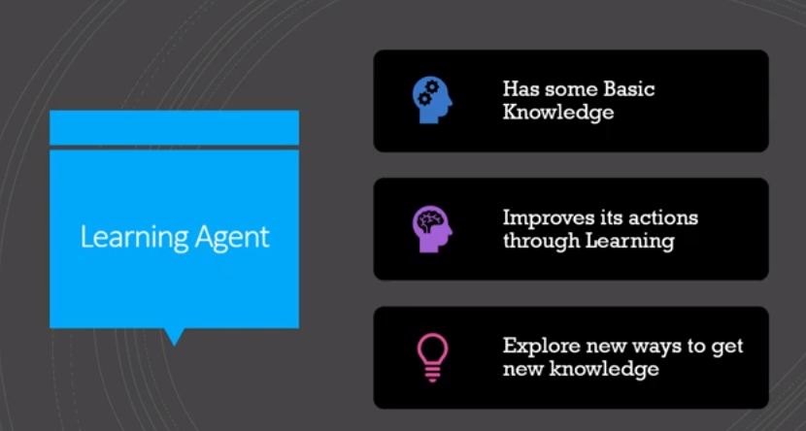
Learning Agents
A learning agent in AI is the type of agent which can learn from its past experiences, or it has learning capabilities.
It starts to act with basic knowledge and then able to act and adapt automatically through learning.
A learning agent has mainly four conceptual components, which are:

Slide 95
Learning Agents
  Learning element: It is responsible for making improvements by learning from environment
  Critic: Learning element takes feedback from critic which describes that how well the agent is doing with respect to a fixed performance standard.
  Performance element: It is responsible for selecting external action.
  Problem generator: This component takes input from other components and suggest actions that will lead to new and informative experiences

Slide 96
Learning Agents
Hence, learning agents are able to learn, analyze performance, and look for new ways to improve the performance.

Slide 97
How the components of agent programs work
Atomic, Factored & Structured
Atomic:
An atomic representation is one in which each state is treated as a black box.
Atomic models have no internal structure; the state either does or does not match what you're looking for.
In an atomic representation , each state of the world is indivisible.
In a sliding tile puzzle, for instance, you either have the correct alignment of tiles or you do not.
Consider the problem of finding a driving route from one end of a country to the other via some sequence of cities
AI algorithms: search, games, Markov decision processes, hidden Markov models, etc.

Slide 98
How the components of agent programs work
Atomic, Factored & Structured
Factored :
A FACTORED representation splits up each state into a fixed set of variables or attributes, each of which can have a value.
Two different factored states can share some attributes
A factored representation is one in which the states are defined by set of features.
E.g., GPS location, amount of gas in the tank.
AI algorithms: constraint satisfaction, and Bayesian networks.

Slide 99
How the components of agent programs work
Atomic, Factored & Structured
Structured Representation:
A structured representation is one in which the states are expressed in form of objects and relations between them. Such knowledge about relations called facts.
AI algorithms: first-order logic, knowledge-based learning, natural language understanding.
The axis along which atomic, factored, and structured representations lie is the axis of increasing expressiveness.

Slide 100
Examples:
atomicState == goal: Y/N / Is goal reached?
factoredState{18} == goal{42}: N // Is goal reached?
diff( goal{42}, factoredState{18}) = 24 // How much is difference?
11grade@schoolA{John(Math=A-), Marry(Music=A+), Job1(doMath)..} == goal{50% ready for jobs}

Slide 101
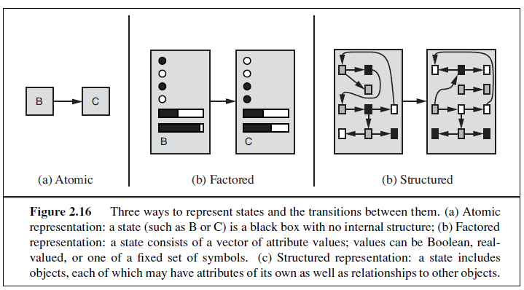

Slide 102
Sample Questions
What is AI? Describe four different aspects AI.
Explain different types of Agents.
1. Simple Reflex agent
2. Model based agent
3. Goal based agent
4. Utility Based agents
5. Learning based agents
Explain agent & its environment with its major components with example.
What is Rational agent? Explain characteristics of rational agent.

Slide 103
What is PEAS representation? Explain its with example.
Describe structure of an agent with its goals
Which are different types of task environment in which agent can work?

